Slide 1
A click chemistry amplified nanopore assay for ultrasensitive quantification of HIV-1 p24 antigen in clinical samples
March 30, 2023
Chunlin Min
Wei, X., Wang, X., Zhang, Z. et al. A click chemistry amplified nanopore assay for ultrasensitive quantification of HIV-1 p24 antigen in clinical samples. Nat Commun 13, 6852 (2022). https://doi.org/10.1038/s41467-022-34273-x

Slide 2
Outline
Background
HIV
Click Chemistry
Nanopore
Paper
Opinions

Slide 3
Background

Slide 4
Human Immunodeficiency Virus (HIV)
HIV is a virus that attacks the body’s immune system. There is no cure, but treatments with antiretroviral therapy (ART) can stop further progression of HIV
HIV can be transmitted via bodily fluids
progression: Acute HIV -> chronic HIV -> AIDS
20% of new HIV infections are due to transmission from unaware infected individuals
Circulating RNA and antigen p24 are long recognized as significant biomarkers for HIV-1
Earlier studies suggest antigen p24 is a stronger predictor of progression to acquire AIDS than was RNA. However, proteins cannot be amplified like nucleic acid, which makes it challenging to achieve good sensitivity for p24 detection

Slide 5
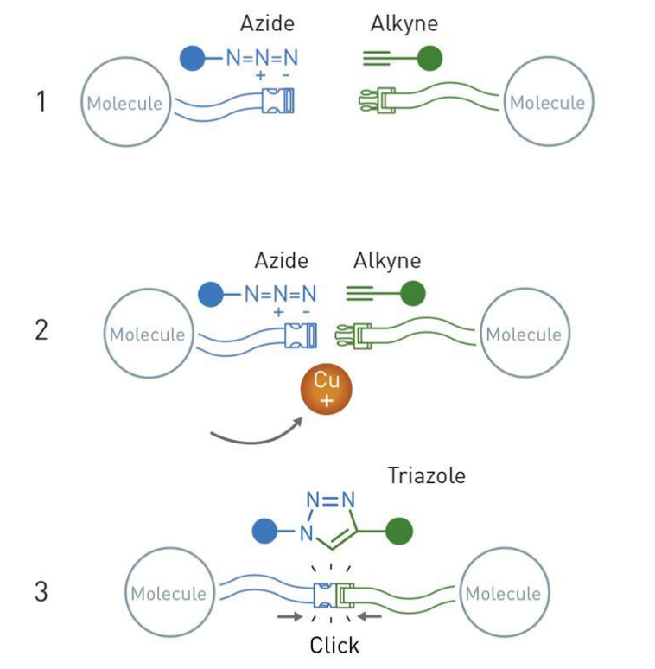
Click Chemistry
Convenient way of doing chemistry
Simple & no waste
Crown jewel of click chemistry: the copper catalyzed azide-alkyne cycloaddition
Widely utilized and reliable way of forming connections between different functional groups

Slide 6
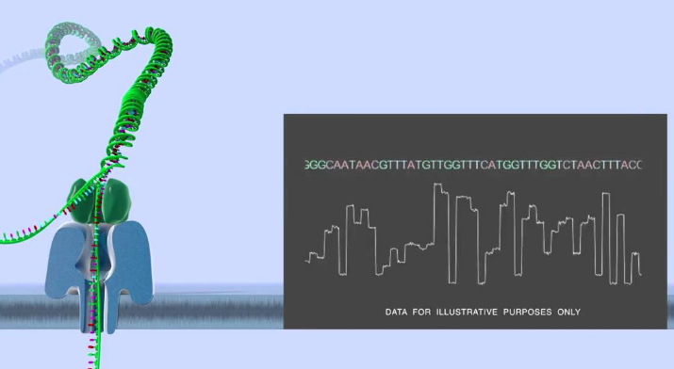
Nanopore
Literally a nano sized pore on a membrane
The pore and membrane can be biological, solid-state, or a hybrid complex of biological and solid-state
Principles
Apply a voltage across the membrane
Induced ion current is measured
Analyte passing through the pore causes current blockade (translocation event) and exhibits a unique signature
Analyte concentration correlate to frequency of translocation events
Challenges
Statistical in nature, requires at least nanomolar level of analyte concentration to operate practically
Direct application in complex clinical samples with interferent molecules

Slide 7
Paper

Slide 8
Motivations
Lower transmission rates for HIV and improve patient outcomes by extending detection window and monitoring capacity of HIV biomarker assays
Achieved through a lower limit of detection (LOD) and accurate quantification
Existing assays for HIV have either unsatisfactory sensitivity or has not made successful translation through clinical studies
PCR techniques for detecting circulating RNA is costly, time consuming, and does not have significant correlation with host immune parameters, such as infection-fighting CD4 cells, like p24 antigen does
This paper presents a nanopore assay amplified by click chemistry for detection of HIV-1 p24 antigen in clinical samples

Slide 10
Opinions

Slide 11
Opinions?
Graphs are properly labeled, easy to interpret, coloring is generally consistent
Detection mechanism diagram shows both positive and negative detection scenarios
The only novelty is in the copper ion delivery system where each captured analyte yield 4 copper ions instead of 1
Nothing said about significance of DNA sequence used or why the linking happens at middle position of sequence
Not sure how specificity is calculated in Fig 5.c
Would like to see a diagram of the nanopore assay
Unclear if assay uses single nanopore or a matrix of nanopores for detection
Important to reduce time and cost of assay

Slide 12
References

